Slide 1
DATA WAREHOUSING
Introduction and Overview
Notes:
45

Slide 2
What is a Data Warehouse?
A complete repository of corporate data extracted from transaction systems that is available for ad-hoc access by “knowledge workers.”
Notes:
45

Slide 3
What is a Data Warehouse? (2)
The data warehouse is an information environment that
  Provides an integrated and total view of the enterprise (data)
  Makes the enterprise’s current and historical data easily available for decision making
  Makes decision-support transactions possible without hindering operational systems
  Renders the organization’s information consistent
  Presents flexible and interactive source of strategic information

Slide 4
What is a Data Warehouse? (3)
A DW is a simple concept
  Take all the information in the organization, clean and transform it, and then provide useful strategic information based on it
  This concept was born out of need, and realization that large quantities of data exists in disintegrated chunks within an organization
A DW is a computing environment, not a product
  Not a single hardware or software product; rather it is an environment built with different hardware, software, and people connected by various processes
  It is a user-centric environment, driven by the needs of the decision maker
  It is a flexible environment for data analysis

Slide 5
What is a Data Warehouse? (4)
A blend of technologies
  Data acquisition
  Data modeling
  Data management
  Data cleaning
  Metadata management
  Storage management
  Applications
  Management tools
Data warehousing is new kind of computing environment geared towards strategic information

Slide 6
The Need for DW
The need for strategic information
  Competitive edge
  Improve performance (revenue, profits, etc)
Characteristics of strategic information
  Integrated
  Data integrity
  Accessible
  Credible
  Timely

Slide 7
Data Glut…
We are drowning in data, but we have little knowledge
  The data is not accessible for strategic information and decision making
  Many enterprises have separate databases for sales, human resources, payroll, products and services, etc
Operational systems
  They maintain record of events for day-to-day operations
  They are not accessible easily for analysis and strategic information

Slide 8
Strategic Information Scarcity…
Executives are interested in strategic information that can help them make decisions regarding their business’s direction and growth
  Strategic information is extracted or discovered from large quantities of data; it requires analysis of easily accessible and clean data
Data warehousing is a solution for the ‘data glut, knowledge scarcity’ problem; it is essentially a kind of decision-support system

Slide 9
Failure of Earlier Decision-Support Systems
The need for strategic information has existed from the earliest days of competitive business
Ad hoc reports
Special extraction programs
Small applications
Decision-support systems
Executive information systems
Data warehousing

Slide 10
Data Warehouse and Operational Systems
Operational systems – OLTP
  Making the wheels of business turn
Data warehouse
  Watching the wheels of business turn
Different scope, different purposes

Slide 11
How are they Different? (1)
Consolidates operational and historical data.
Usually (but not always) periodic or batch updates rather than real time.
Starts out with a 6x12 availability requirement...but 7x24 usually becomes
the goal.
Notes:
46

Slide 12
How are they Different? (2)
Operational systems run the business -- DW gives insight into how to improve the business.
Data warehousing goes beyond traditional MIS by allowing interactive data exploration by end-users.
Database structures designed to support DSS: star schema, denormalized tables, sampling, etc.
  Tradeoffs must be carefully evaluated.
Notes:
47

Slide 13
How are they Different? (3)
 | Operational | Informational
Data content | Current values | Archieved, derived, summarized
Data structure | Optimized for transactions | Optimized for complex queries
Access frequency | High | Medium to low
Access type | Read, update, delete | Read
Usage | Predictable, repetitive | Ad-hoc, random, heuristic
Response time | Sub-seconds | Several seconds to minutes
User | Large number | Relatively small number

Slide 14
Typical Applications
Impact on organization’s core business is to streamline and maximize profitability.
  Fraud detection.
  Profitability analysis.
  Direct mail/database marketing.
  Customer retention modeling.
  Credit risk prediction.
  Inventory management.
  Yield management.
ROI on any one of these applications can justify HW/SW costs in most organizations.
Notes:
49

Slide 15
Typical Early Adopters
Financial service/insurance.
Retailing and distribution.
Telecommunications.
Transportation.
Government.
Common thread: lots of customers and transactions.
Notes:
50

Slide 16
What Are End User Expectations?
Point and click access to data.
Insulation from DBMS structures.
  Want semantic data model - not 3rd normal form.
Integration with existing tools: SAS, Excel, etc.
Interactive response times for on-line analysis...but batch is important, too.
Notes:
55

Slide 17
Quantification of Response Times
On-line analytical processing (OLAP) queries must be executed in a small number of seconds.
  Often requires denormalization and/or sampling.
Complex query scripts and large list selections can generally be executed in a small number of minutes.
Sophisticated modeling algorithms (e.g., data mining) can generally be executed in a small number of hours (even for millions of customers).
Notes:
56

Slide 18
Desired Features of DW
Database designed for analytical tasks
Data from multiple sources
Easy to use and conducive to long interactive sessions by users
Read-intensive data usage
Direct interaction of the user with the system
Content updated periodically and stable
Ability for users to run queries and get results online
Ability for users to initiate reports

Slide 19
Business Intelligence
Data warehousing supports business intelligence
What is BI?
Business Intelligence is a process that adds value to your business processes through monitoring performance indicators about business environment and their impact on business strategy to help define, refine and improve business model for Profitable Operations
In lay terms, BI entails
  Ability run simple queries
  Ability to perform ‘what if’ analyses in different ways
  Ability to interactively analyze results
  Ability to discover trends and apply them to future results

Slide 20
Data Warehouse High-level Implementation Steps
1. Identify key business requirements.
2. Identify key data sources and volumes.
3. Identify phased deliverables with quantifiable business benefits.
4. Software/hardware selection.
5. Data warehouse construction.
-Data extraction and cleansing.
-Logical and physical design.
-Software integration.
6. Productionalize.
7. Go to step one for next deliverable.
Notes:
58

Slide 21
Information Evolution in a Data Warehouse Environment
STAGE 1:
REPORT
WHAT happened?
STAGE 2:
ANALYZE
WHY did
it happen?
STAGE 3:
PREDICT
WHAT will
happen?
STAGE 4:
OPERATIONALIZE
What IS happening?
STAGE 5:
ACTIVATE
What do you WANT to happen?
Primarily Batch
Increase in Ad Hoc Queries
Analytical Modeling
Grows
Continuous Update &
Time Sensitive Queries Become Important
Event Based Triggering
Takes Hold
Batch Ad Hoc Analytics
Continuous Update/Short Queries Event-Based Triggering

Slide 22
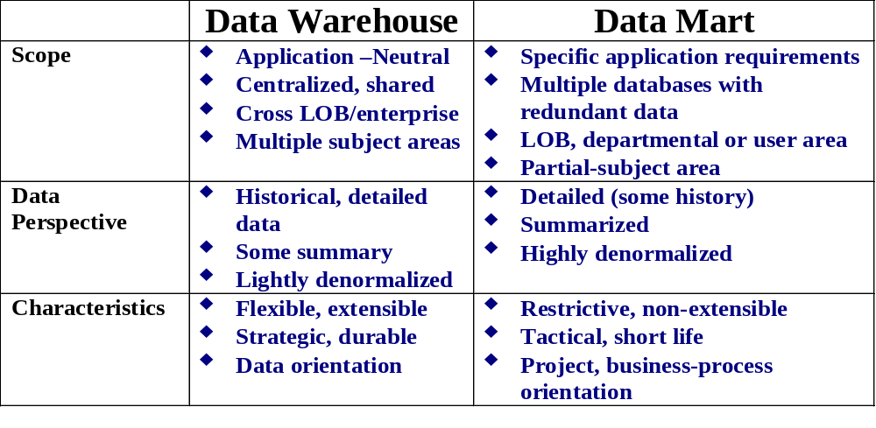
Data Warehouse and Data Marts
Source: Gartner Group, Kevin Strange
Notes:
This adaptation from a Gartner Group chart highlights the classic differentiation between data warehouses and data marts. Vendor marketing and overloaded terminology has often confused the factors that influence this differentiation. Lately, there is a new kind of data repository that has started to emerge, called the Operational Data Store (ODS), to support more timely and high-performance decision support than has been designed into “traditional” data warehouse deployments. Ideally, your data warehouse design would be high-performance enough to obviate the need to create yet another repository of this sort. Today, our primary focus will be on the data warehouse and, to a lesser extent, on “dependent” data marts.
The key focus of a data warehouse, in contrast to a data mart, is to support enterprise decision support that is not limited to specific application or LOB (Line of Business) boundaries. Data marts contain summarized, subset data typically designed to meet the needs of a specific application or LOB.

Slide 23
Which One First?
Top-down approach or bottom-up approach?
Enterprise-wide or departmental?
What first – one data warehouse or multiple data marts?
Build pilot or go with a full-fledged implementation
Dependent or independent data marts

Slide 24
A Practical Approach
Chief proponent of this approach is Kimball
The practical approach
  Plan and define requirements at the overall corporate level
  Create the architecture for a complete warehouse
  Conform and standardize the data content
  Implement the data warehouse as a series of marts, one at a time
In this approach, a data mart is a logical subset of the entire data warehouse (dependent data marts)

Slide 25
A Typical Data Warehouse Environment
IT Users
Operational Data
Data Transformation
Enterprise Warehouse and
Integrated Data Marts
Replication
Dependent Data Marts or
Departmental Warehouses
Business Users
Notes:
This diagram portrays a high-level data warehouse environment. Data transformations may take place inside or outside of the RDBMS (e.g., ELT versus ETL), depending on availability of resources, data transformation tool selection, RDBMS scalability, and so on.
Notice that the data marts shown are derived explicitly from data replicated (with summarization and subsetting) out of the data warehouse. This guarantees consistency of data when providing drill-through from summarized data (in the mart) to the detailed data (in the enterprise warehouse). Data marts may or may not be stored in relational structures. It is not uncommon to construct data marts using SAS data sets, cubes, or other proprietary file structures to meet the need of specific tools or performance SLAs (service level agreements).
It is essential that the data mart strategy be well-thought in its deployment. You do not want a proliferation of data marts because that dramatically increases total cost of ownership (TCO). See recent studies by both Meta Group and Gartner Group. You also want to avoid the “end run” strategy where “independent” data marts are constructed without enforced data consistency with the enterprise warehouse.

Slide 26
DW Building Blocks or Components
Key architectural components of a DW
  Data source
  Data staging
  Data storage
  Information and delivery
  Management and control

Slide 27
Source Data
Production data - data from operational systems
  Major issue: disparity (different formats, management systems, interfaces, hardware, software, etc)
Internal data – data from ‘private’ (not widely available) sources like spreadsheets, access databases, files, records, etc
  Major issues: selecting internal data, deciding on whether to incorporate internal data,
Archived data – backup data from operational systems
  Major issues – deciding how much archived data to include
External data – data from data analysis agencies
  Major issue: selecting relevant data, integrating the data

Slide 28
Data Staging
Area where data is prepared for the data warehouse
Major functions
  Extraction
  Transformation
  Loading

Slide 29
Data Storage
The data storage is a separate repository
Being a separate repository, it has its own
  DBMS (using a RDBMS or a MDDBMS)
  Hardware and software
  Administration tools

Slide 30
Information Delivery

Slide 31
Metadata
Data about data in the DW
Similar to the data dictionary and data catalog in database management system

Slide 32
Management and Control
Manages and controls all other components of the data warehouse
  ETL
  Information delivery
  User accounts and access
  Batch updating
Management and control component interacts with the metadata

Slide 33
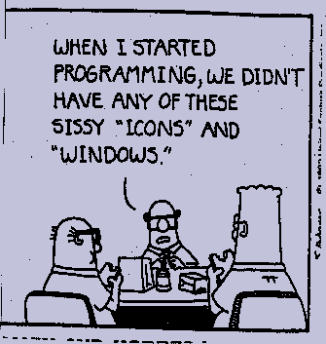
Why is this Hard?

Slide 34
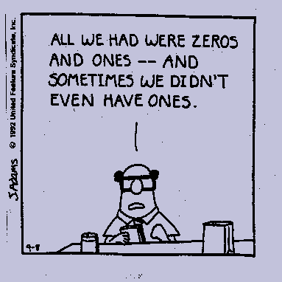
Why is this Hard?

Slide 35
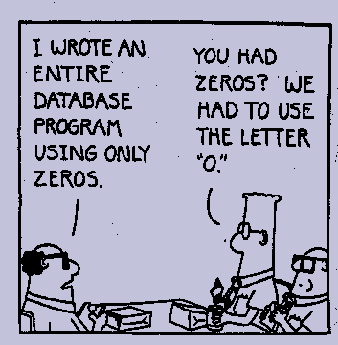
Why is this Hard?

Slide 36
Why is this Hard?
There are no stable requirements in a data warehouse environment.
Familiar database techniques break down in DSS at large scale.
The scale factor in VLDB implementations is difficult to comprehend.
Performance impacts are often non-linear.
Complex architectures for deployment.
Rapidly changing product characteristics.
And so on...

Slide 37
Approach
Develop an understanding of underlying RDBMS implementation techniques.
Apply these techniques to VLDB DSS environments and understand where they break down.
Provide a “toolkit” of design techniques for maximizing performance in a variety of data warehouse implementation scenarios.
Place particular emphasis on harnessing parallel technology as a means of overcoming scale.

Slide 38
Considerations
Logical and physical data modeling.
OLAP implementation techniques.
Extract, transform, and loading of data.
Indexing structures.
Join algorithms.
Parallel processing deployment.
Data mining.
Data quality management.
Capacity planning and service level agreements.
Platform configuration.
Data warehouse architecture.

Slide 39
Reality Check
Hardware is the easyware…
…software is the hardware.

Slide 40
Reality Check
If the software doesn’t scale, it doesn’t matter how much your hardware can scale up!

Slide 41
Amdahl’s Law
Sequential Execution:
Ideal Parallel Execution:
Let “s” be the fraction of the program that must be performed sequentially.
Notes:
Data dependencies between different phases of computation introduce synchronization requirements that force sequential execution. Moreover, there is a wide range of capabilities available in commercially implemented software in regard to the level of granularity at which parallelism can be exposed.
As shown in the charts above, the goal of ideal parallel execution is to completely parallelize those parts of a computation that are not constrained by data dependencies. The smaller the portion of the program that must be executed sequentially (s), the greater the scalability of the computation.

Slide 42
Amdahl’s Law
Quantitative representation:
SpeedUp = 1 / ( Percent Sequential + (Percent Parallel / # of Processors) + Overhead)
SpeedUp = 1 / ( 0.1 + (0.9 / 4) + 0 ) = 3.08
The keys to parallel performance:
  Amount of parallelism
  Overhead management
Notes:
The processing for parallel tasks can be spread across multiple processors. So, if 90% of our processing can be parallelized and 10% must be serial we can speed up the process by a factor of 3.08 when we use four independent processors for the parallel portion. This example also assumes 0 overhead and “perfect” parallelism. Thus, a database query that would run for 10 minutes when processed serially would, in this example, run in 2.63 minutes (10/3.08) when the parallel tasks were executed on four independent processors.
As you can see, if we increase the overhead for parallel processing or decrease the amount of parallelism available to the processors, the time it takes to complete the query will increase according to the formula above.

Slide 43
Amdahl’s Law
100
90
80
70
60
50
40
30
20
10
0
100 Processors
50 Processors
25 Processors
10 Processors
0 2 4 6 8 10 12 14 16 18 20 22 24
% Sequential Execution
Notes:
As we can see in this graphical representation of Amdahl’s Law, the realized benefit of additional processors is significantly diminished as the amount of sequential processing increases. In this chart, the vertical axis is the number of processors in the system. As the overall percentage of sequential processing increases (with a corresponding decrease in parallel processing) the relative effectiveness (utilization) of additional processors decreases. At some point, the cost of an additional processor exceeds the incremental benefit.

Slide 44
Parallel Processing: The Impact
How long to read a Terabyte of data?
  Question posed in Information Week article on VLDB implementations.
  Answer provided: 1.2 days, serially.
Parallel Processing can speed-up
  0.6 Days with 2 parallel tasks
  Less than 18 minutes with 100 parallel tasks, provided that:
    Software has even distribution of tasks.
    Hardware can sustain I/O levels.

Slide 45

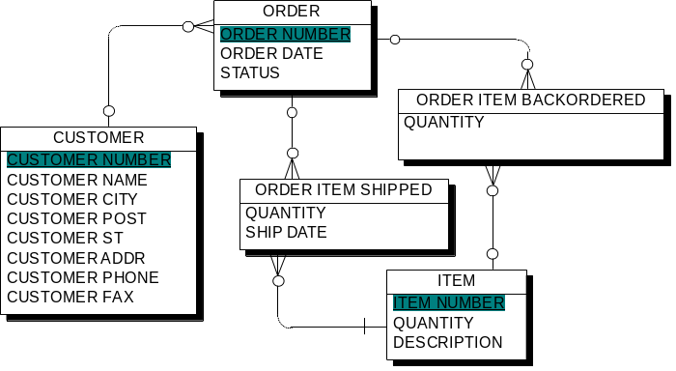
Scalability - It Is Not Just About Size
Amount of Detailed Data
Concurrent Users
Complexity of Data Model
Query Complexity
  Simple Direct at the start
Moderate Multi-table Join
Regression analysis
Query tool support
Notes:
It is common today for vendors and customers to boast about the size of their data warehouses. And, in fact, size does matter. But it is not size alone. Rather, significant increases in data volume amplifies the issues associated with increasing numbers and varieties of users, greater complexity and richness in the data model, and increasingly sophisticated and complex business questions. Scalability is also about providing great flexibility and analysis potential through richer, albeit more complex, data schemas. Finally, it is just as important to allow for the increasing sophistication of the data warehouse users and evolving business needs. Although the initial use of many data warehouses involves simple, canned, batch reporting many companies are rapidly evolving to far more complex, ad hoc, iterative (not repetitive) business questions – “any query, any time” or “query freedom”.

